Slide 1
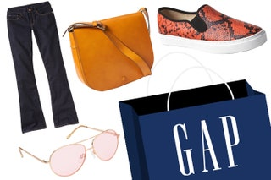
Market Segmentation and Analysis of GAP Brand Customers
Sreeja Yalamaddi yxm265
Notes:
Slide 1: Title Slide "Hello, my name is Sreeja Yalamaddi, and today I'll be presenting my final project titled Market Segmentation and Analysis of GAP Brand Customers. This analysis aims to uncover actionable insights for targeted marketing and product strategies through data-driven segmentation."

Slide 2

Objective
Goal: Analyze GAP brand customers' demographics, behaviors, and preferences to uncover actionable insights.
Outcome:
Identify key customer segments for GAP Jeans.
Provide strategies for targeted marketing, loyalty improvement, and product development.
Notes:
"The goal of this project was to analyze and understand the demographics, behaviors, and preferences of GAP brand customers using segmentation techniques. This research identifies key customer segments, uncovers opportunities for loyalty improvement, and provides strategic insights for GAP."

Slide 3
Approach to Market Segmentation Analysis
Data: Insights from the Simmons National Consumer Survey, focusing on consumer attitudinal behaviors and lifestyle preferences.
Analytic Techniques:
Dimensionality Reduction : Simplifies complex data by creating abstract constructs that represent key consumer behaviors and preferences.
K-Means Clustering: Segments consumers based on single driver variables and PCA-derived factors to identify distinct behavioral groups.
Gap Analysis: Ensures clusters are meaningfully distinct for effective segmentation.
Cluster Selection & Cluster Profiling : The optimal cluster solution is identified based on clear differentiation across clusters using K-Means and Gap Analysis. Selected clusters are then analyzed with descriptive variables to extract actionable insights.
Notes:
"I started with the Simmons National Consumer Survey data, focusing on consumer behaviors and lifestyle preferences. The analysis involved techniques like dimensionality reduction using PCA, K-Means clustering, and GAP analysis for optimal segmentation. Cluster profiling was used to interpret the insights."

Slide 4
Variable Selection | Target & Single Driver Variables
‘ If GAP brand was bought in past 12 months’ is selected as target variable
Further selected five key attitudinal variables to which might get good understanding of customer behavior
Stick with Classic Styles
Like to Keep Up with the Latest Fashions
Dress to Please Myself
Have Favorite Clothing Brands
Everything I Wear is the Highest Quality
These statements reflect consumer motivations, such as:
Fashion Preferences
Brand Loyalty
Attitudes Toward Quality
By analyzing these variables, we uncover valuable insights into customer behavior and purchasing patterns, enhancing the precision of cluster identification.
Notes:
"The target variable was whether a GAP brand product was purchased in the last 12 months. Five key attitudinal variables were selected: sticking to classic styles, keeping up with fashion trends, dressing for oneself, loyalty to favorite brands, and prioritizing high-quality products. These variables reflect customer motivations, aiding precise cluster identification."

Slide 5
Variable Selection | Abstract Constructs
Fashion Orientation
Impulse Buying: Often buy clothes I don’t really need.
Fashion Influence: Fashion magazines play a major role in my purchase decisions.
Style Experimentation: I enjoy trying out new and bold fashion styles.
Celebrity Influence: I tend to buy products that celebrities endorse or use.
Practicality Orientation
Brand and Image: Designer labels improve a person’s image.
Functionality: The functionality of clothing is the most important factor in my purchases.
Durability: I make my clothes last as long as possible.
Comfort: Comfort is the most important consideration when buying clothes
Notes:
"Next, I derived two constructs: Fashion Orientation and Practicality Orientation. Fashion Orientation includes factors like impulsive buying, influence of magazines, and celebrity endorsements. Practicality Orientation focuses on durability, comfort, and functionality."

Slide 6
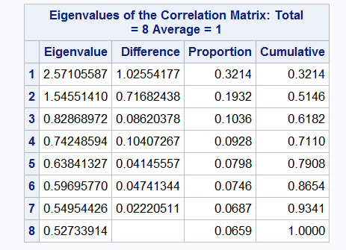
Dimensionality Reduction | PCA – Eigen Value Table
Factor Extraction Criteria: Use the Kaiser Criterion, retaining factors with eigenvalues > 1.
Number of Factors: Two factors were extracted, explaining 51.46% of the variance.
Extraction Technique : PCA for dimensionality reduction and maximizing variance
Rotation Method : Varimax Rotation is used for simpler interpretation of variable contribution to each factor
Notes:
"Using PCA, two factors were retained, explaining 51.46% of the variance.

Slide 7
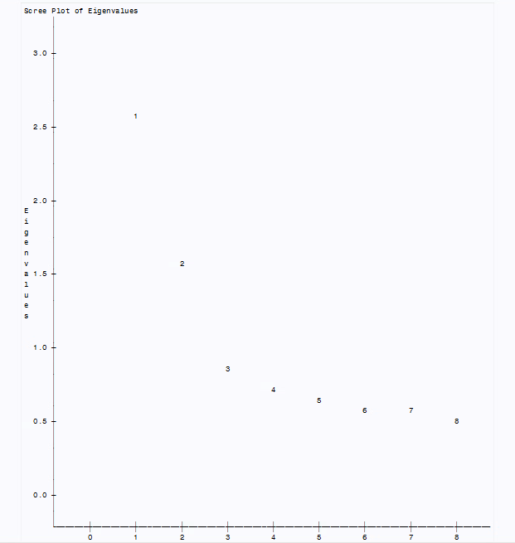
Dimensionality Reduction | PCA - Scree Plot
The plot shows a sharp decline in eigenvalues after the second factor suggesting that the first two factors explain a significant amount of variance
Notes:
The scree plot shows a clear drop after the second factor, affirming this choice. This dimensionality reduction simplified the data for clearer insights."

Slide 8
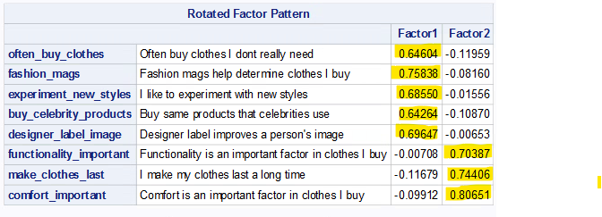
Dimensionality Reduction | PCA - Factor Pattern Matrix
Factor 1: Fashion Orientation
Frequent buying of clothes (often_buy_clothes)
Influence of fashion magazines (fashion_mags)
Interest in experimenting with new styles (experiment_new_styles)
Buy same products that celebrities use (buy_celebrity_products)
Designer label improves a person's image (designer_label_image)
Factor 2: Practicality Orientation
Importance of functionality (functionality_important)
Preference for making clothes last (make_clothes_last)
Emphasis on comfort (comfort_important)
Notes:
"The PCA results classified Fashion Orientation with traits like frequent buying and interest in experimentation, while Practicality Orientation included functionality and comfort. These constructs guided the clustering process."

Slide 9
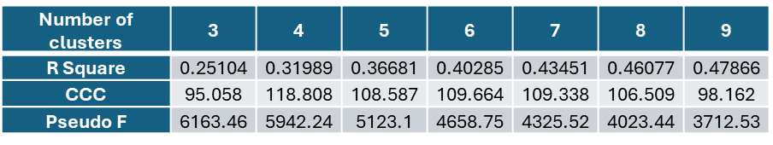
K Means Clustering | Best Number of Clusters
With Abstract Constructs as factors and Single Driver variables , we utilize K Means clustering to find a proper cluster solution for our respondents.
The table below shows the R Square, Cubic Cluster Criterion (CCC), and Pseudo F values for each corresponding cluster solution.
The Pseudo F-statistic values decrease steadily as the number of clusters increases beyond k=3. Based on k values considered, there does not appear to be a local maximum for the Pseudo F-statistic.
The CCC suggests that 4 clusters is a good choice

Slide 10
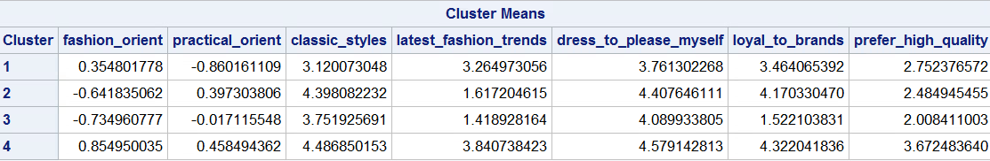
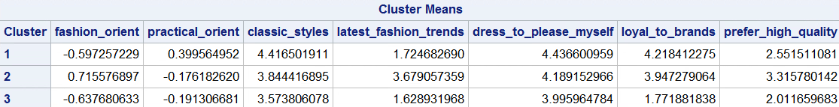
K Means Clustering | Best Cluster Solution
Based on K-Means results, the 4-cluster solution has fewer ties (7.14%) than the 3-cluster solution (14.29%).
Therefore, while the 3-cluster solution is viable, The 4-cluster solution was chosen for better differentiation.

Slide 11
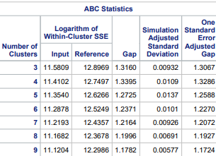


GAP Analysis
Gap Analysis provides us additional options for creating our clusters. We can see that first peak and global peak methods states that 4 clusters is the appropriate solution.
Based on the means of the driver variables for the 4-cluster solution, the percentage of ties is 8.33%.
Both K means and GAP Analysis suggest 4 clusters solution but number of ties from gap analysis > k means, so clusters from k means is better solution.

Slide 12
Descriptor Variables
Descriptor variables used to profile clusters:
Age group
Income Group
Gender
Gap Jeans Bought
Wrangler Jeans Bought
Levi's Jeans Bought
Calvin Klein Jeans Bought
Read Cosmopolitan Magazine
Watch Shark Tank
Reliance on TV
Eco Friendliness of Companies
Look for Special Offers
Notes:
"Descriptor variables such as age, income, gender, and purchasing behaviors were used to profile the clusters. Media engagement and eco-consciousness were also considered for deeper segmentation."

Slide 13

GAP Market Segments : “What starts here shapes culture”
Value Seekers
Profile: Aged 25-34, low income, slightly female-skewed.
Traits: Focus on affordability, practicality, and special offers.
Gap Appeal: Emphasize budget-friendly, everyday styles.
Sustainability Advocates
Profile: Aged 25-34, eco-conscious, slightly more female-dominated.
Traits: Value sustainability, engage with TV and lifestyle content.
Gap Appeal: Highlight eco-friendly initiatives and sustainable designs.
Pragmatic Minimalists
Profile: Aged 35-49, balanced gender representation.
Traits: Value simplicity, practicality, low media engagement.
Gap Appeal: Focus on timeless, functional, and versatile clothing.
Quality Enthusiasts
Profile: Aged 50+, higher income, balanced gender representation.
Traits: Value quality, brand loyalty, moderate media engagement.
Gap Appeal: Emphasize premium, sustainable styles and brand trust.
Notes:
"The analysis revealed four distinct segments:
Value Seekers: Young, budget-conscious individuals who focus on affordability and practicality.
Sustainability Advocates: Eco-conscious consumers who prioritize sustainable products.
Pragmatic Minimalists: Middle-aged individuals preferring timeless, functional clothing.
Quality Enthusiasts: Older, higher-income customers with a strong focus on quality and brand loyalty.
Each segment offers unique opportunities for GAP’s marketing and product strategies."

Slide 14
Conclusion
Key Takeaways
GAP’s customers segment into four distinct clusters:
Value Seekers, Sustainability Advocates, Pragmatic Minimalists, and Quality Enthusiasts.
Each cluster offers actionable insights for targeted marketing and product strategies.
The segmentation highlights opportunities for growth in eco-conscious and quality-focused demographics.
Next Steps
Targeted Marketing Campaigns:
Develop promotions tailored to the preferences of each cluster.
Sustainability Initiatives:
Launch eco-friendly product lines to attract Sustainability Advocates.
Loyalty Programs:
Create incentives for Quality Enthusiasts to drive long-term engagement.
Notes:
In conclusion, the segmentation identifies actionable opportunities for GAP. Suggested next steps include:
Tailored marketing campaigns for each segment.
Developing eco-friendly product lines to engage Sustainability Advocates.
Creating loyalty programs for Quality Enthusiasts to boost long-term engagement.
This research provides GAP with a foundation for data-driven, customer-focused strategies."

